Slide 1
ONLINE
|
JAKARTA, ID
$
whoami
--
BUILDING TOMORROW'S TECH
IBNU
Artificial Intelligence
•
Blockchain
•
Cybersecurity
>
exploring_
_
CIVIL SERVANT (ASN)
2026 PERSONAL BRAND DECK
Ministry of Housing & Settlement Areas
heyibnu.com

Slide 2
$
stats --verbose
The Numbers That Define Me
Key metrics from a multi-domain expertise journey
97+
$68-100K
Certifications
Trading Volume
From Harvard, Stanford, Google, IBM, McKinsey & more. Spanning AI, Security, Finance, Strategy, and Leadership across 6 major categories.
Active DeFi participant since 2021. CEX & DEX experience with disciplined risk management and thesis-driven portfolio strategy.
2
5+
Advanced Degrees
Companies Led
MBA UGM (GPA 3.60/4.00) + S.Kom Telkom University (GPA 3.34/4.00). 2nd Best Outstanding Graduate.
Cross-sector experience: IT, Healthcare, F&B, Retail, and Government. From startup founder to C-level executive to civil servant.
// Civil servant by day, crypto trader by night, AI builder in between.

Slide 3
$
whoami --verbose
From Bureaucrat to Builder
Civil servant by day,
career_timeline.json
AI builder in between.
crypto trader by night,
2024 – PRESENT
CURRENT
This isn't a contradiction—it's a strategy. I'm an M-shaped professional with 5+ years of cross-functional experience, deliberately building expertise across multiple domains simultaneously.
Ministry of Housing & Settlement Areas
Civil Servant (ASN)
Managing information systems processing 500K+ housing subsidy applications annually. Building HUB PKP digital ecosystem for 50M+ homes.
2021 – 2024
philosophy
PT Sambel Korek DNO
"You can't build what you haven't used."
Director of Operations (COO)
Every technology I work with, I use personally. From trading DeFi protocols to deploying AI systems for government—practitioner first, theorist never.
Led company to 40% revenue growth and expanded to 200+ retail partners. Managed portfolio value >IDR 1T (~USD 71M).
2019 – 2022
Automate All (CV Solusi Automasi Indonesia)
Founder & CEO
CURRENT ROLE
Built Indonesia's first RPA-focused startup. Deployed 100+ bots across 50+ clients, reducing document processing time by 80%+. Achieved IDR 1B valuation.
Civil Servant (ASN)
Ministry of Housing & Settlement Areas • 2024–Present
TOP 100 STARTUP
NUS BLOCK71
2017 – 2021
Telkom University
S.Kom in Informatics
GPA 3.34/4.00 • 2nd Best Outstanding Graduate (Innovation & Entrepreneurship)

Slide 4
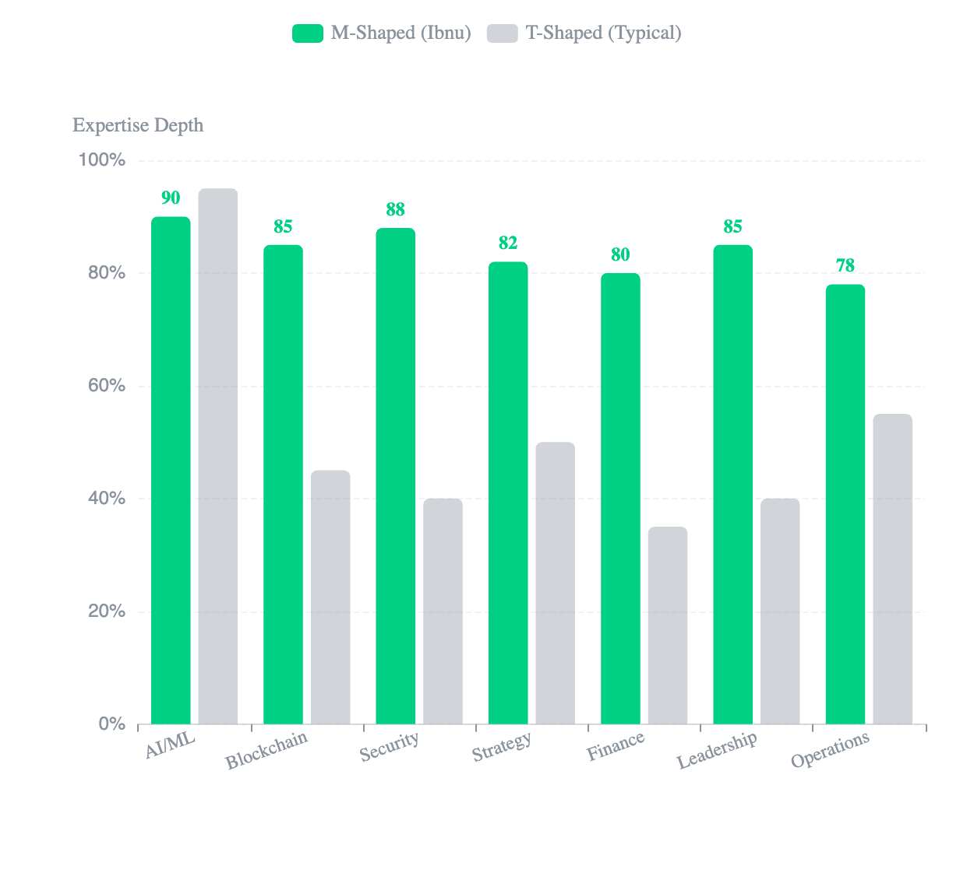
<
M-Shaped Expertise
/>
M-Shaped (Not T-Shaped)
Deep expertise across multiple domains simultaneously — deliberately
expertise_visualization
M-Shaped (Ibnu)
T-Shaped (Typical)
Why M-Shaped?
T-shaped = one deep expertise. M-shaped = multiple deep expertise areas.
I deliberately chose to build depth across AI, Blockchain, and Security simultaneously. The future belongs to those who can operate at the intersection.
skills_breakdown.json
12
54
Domains
Skills
80%
5+
Avg Proficiency
Years Experience
domains
AI/ML
Blockchain
Security
Strategy
Finance
Leadership

Slide 5
$
cat convergence.matrix
The Convergence
AI × Blockchain × Cybersecurity = The Complete Future Stack
AI + Security
Intelligent Threat Detection
ML-powered anomaly detection, predictive vulnerability analysis, automated incident response systems.
Blockchain + AI
Decentralized AI Governance
Transparent AI decision-making, token-incentivized learning, distributed model training.
Security + Blockchain
Immutable Audit Trails
Cryptographic record integrity, tamper-proof compliance logs, decentralized identity systems.
The Center
The Complete Future Stack
This is where I operate. Building systems that leverage all three pillars simultaneously.

Slide 6
$
./ai --deploy
Artificial Intelligence
Building intelligent systems that augment human capability
tech_stack.yaml
deployment_metrics.json
LangChain
LangGraph
3+
10K+
AutoGen
CrewAI
AI Systems Deployed
Government Users
RAG
Prompt Eng
Primary Use Cases:
LLM Workflows
Computer Vision
AI-powered document processing & classification
▸
▸
Intelligent citizen assistance chatbots
research_focus.md
▸
Predictive policy analysis systems
Agentic AI & Autonomous Systems
Researching how intelligent agents can perform document-intensive workflows with minimal human oversight—specifically for government administrative processes.
proficiency_levels
LLM Workflows
90%
Multi-Agent
Autonomous
GovTech
Prompt Engineering
80%
Agentic AI
85%
// Future Impact: AI will revolutionize government service delivery through autonomous document processing, intelligent citizen assistance, and predictive policy analysis.

Slide 7

$
./crypto --status
Blockchain & Crypto
Practitioner, not theorist
$68-100K
"You can't build what you haven't used."
Cumulative Trading Volume
Every blockchain protocol I evaluate, I use personally. Every DeFi strategy I analyze, I execute myself. This hands-on experience informs my perspective on regulation, adoption, and real-world utility.
Active DeFi participant since 2021
4+
CEX+DEX
DeFi
Years Active
Multi-Platform
Native
portfolio_allocation
trading_experience
research_focus
▸
CEX: Binance, OKX
▸
On-chain Analysis
▸
DEX: Uniswap, dYdX
▸
Liquidity Research
▸
Futures & Spot
▸
Alpha Generation
▸
Yield Strategies
▸
Smart Contracts
BTC 70%
Altcoin 15%
Memecoin 10%
DEX 5%
relevant_certifications
INSEAD Web3
Blockchain Finance
Smart Contracts
DeFi Protocols
// Future Impact: Blockchain will transform government transparency through immutable records, smart contract-based procurement, and decentralized identity systems.

Slide 8
$
./security --audit
Cybersecurity
Every system is a potential target
Defense + Offense Mindset
core_competencies
Security isn't just about building walls—it's about understanding how attackers think. I approach security from both defensive and offensive perspectives.
OSINT
Threat Intelligence
Open source intelligence gathering and analysis
Proactive threat detection and analysis
70%
75%
Defensive: Protection & Compliance
Offensive: OSINT & Threat Intel
Incident Response
Computer Forensics
Rapid response to security breaches
Digital evidence analysis and recovery
certifications
80%
75%
15+
Security Certifications
certification_details
IBM
INFOSEC
Cisco
IBM Security
INFOSEC
Cyber Security Analyst
Incident Response
Cybersecurity Ops
Cisco
EC-Council
INFOSEC
INFOSEC
PwC
Computer Forensics
Risk Management
Cyber Consulting
compliance_expertise
ISO 27001
BSSN
PP 71/2019
// Future Impact: Security will be the foundation of all digital transformation—protecting AI systems, securing blockchain networks, and ensuring trust in government digital services.

Slide 9
$
cat projects/featured.md
Featured Project: HUB PKP
Digital ecosystem for 50M+ homes — Indonesia's self-built housing transformation
The Problem
impact_metrics.json
84% of Indonesian homes are built through self-construction (swadaya), yet there's no unified digital ecosystem connecting citizens with housing stakeholders.
1M+
500K+
50M+
6
Target Citizens
Annual Applications
Self-Built Homes
Stakeholder Types
6
84%
Stakeholder Types
Homes Covered
The Solution
A 7-module digital platform unifying the entire self-built housing journey—from design to monitoring—integrating all stakeholders in one ecosystem.
tech_stack
7 Integrated Modules:
React
TypeScript
Node.js
1
Design
2
Permits
PostgreSQL
AWS
SIMBG API
3
Materials
4
Workers
5
Finance
6
Monitor
Key Features:
7
AI Consult
▸
AI-powered house design consultation
▸
Integrated permit processing (PBG/SIMBG)
▸
Material marketplace with price comparison
▸
Housing finance integration with banks
// Status: In Development | Ministry of Housing & Settlement Areas, Republic of Indonesia

Slide 10
$
ls -la credentials/
World-Class Credentials
97+ certifications from the world's best institutions
Elite Universities
37
Tech Giants
23
Big 4 & Consulting
18
Harvard University
Google
McKinsey & Company
Stanford University
IBM
BCG, Bain
University of Cambridge
Microsoft
Deloitte, PwC, KPMG
INSEAD
AWS
EY, Accenture
NUS, NTU
Meta, Intel, Cisco
Strategy & Tech
Finance
7
Security
6
AI & Auto
3
Memberships
Goldman Sachs
INFOSEC
Machine Learning
CFA Institute
JP Morgan
EC-Council
AI Engineering
KADIN Indonesia
Bank of America
Cisco
RPA
HIPMI JAYA
Citi, HSBC
IBM Security
Featured Recognition
TOP 100
TOP 20
Top 100 Startup - Ministry of Industry | Top 20 - NUS Enterprise BLOCK71

Slide 11
$
cat education/phd_roadmap.md
Academic Journey & PhD Ambition
Never done learning — from practitioner to researcher
academic_timeline.json
Why PhD?
2021
COMPLETED
Five years of building solutions kept bringing me to the same question: why do some organizations embrace digital transformation while others resist it?
S.Kom in Informatics
Telkom University
A doctorate will provide the research methodology to transform practitioner intuition into systematic knowledge. I want to design systems informed by the bureaucracy where I work.
GPA: 3.34/4.00
• 2nd Best Graduate
2024
COMPLETED
MBA - Senior Executive
Universitas Gadjah Mada (UGM)
research_focus
GPA: 3.60/4.00
• Thesis: Product Strategy
Autonomous AI for Government
2027
TARGET
How intelligent agents can perform document-intensive workflows with minimal human oversight—specifically for Indonesian government administrative processes.
PhD in AI/Information Science
Top 100 Global University
Fall 2027
Fulbright
Australia Awards
LPDP
Agentic AI
Digital Government
AI Governance
Public Sector
research_philosophy
"I want to design systems informed by the bureaucracy where I work, test hypotheses with colleagues I sit alongside, and develop frameworks grounded in institutional realities."
// Vision: Advancing responsible AI development in Indonesia's government—contributing to efficiency gains for 4 million civil servants and bringing Indonesian perspectives to global AI governance.

Slide 12
$
./connect --initiate
Let's Build the Future Together
Full-Time Roles
Technical Leadership & Strategy
▸
CTO, VP Engineering, Tech Lead
▸
AI/ML Engineering & Strategy
Building at the intersection of AI , Blockchain , and Cybersecurity
▸
Blockchain Development & Architecture
— where the future actually lives.
Research Collaboration
Academic & Industry Partnerships
▸
AI for social good initiatives
▸
Government digital transformation
Open source projects
contact_info.json
▸
Website
LinkedIn
heyibnu.com
/subkhanibnuaji
Advisory & Speaking
Consulting & Knowledge Sharing
GitHub
Email
▸
Strategic technology advisory
/subkhanibnuaji
subkhanibnuaji@gmail.com
▸
Conference keynotes & panels
▸
Corporate training & workshops
ONLINE
Typical response: 24-48 hours
© 2026 Subkhan Ibnu Aji. All rights reserved.
Built with
for the future

